Slide 1
Introduction to SPI communication protocol

Slide 2
SPI Protocol
SPI protocol - transmits serial data between devices using a shared clock and dedicated lines for data out and data in.
This protocol uses more pins than UART but can achieve higher data rates due to the synchronous nature of the link.
Master – the device that generates the clock that all devices transfer information.
Serial clock (SCLK) – master clock.

Slide 3
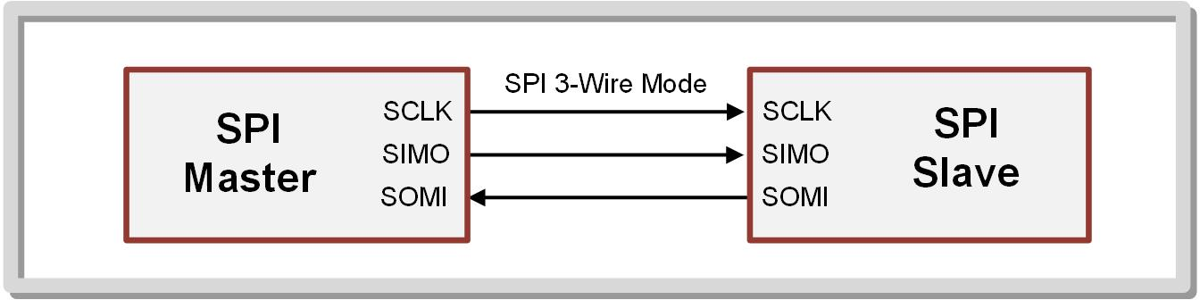
Slave in, master out (SIMO or MOSI) – data line from the master to the slave.
Slave out, master in (SOMI or MISO) – data line from the slave to the master.
The default SPI data frame is 8-bits long with the LSB being sent first.

Slide 4
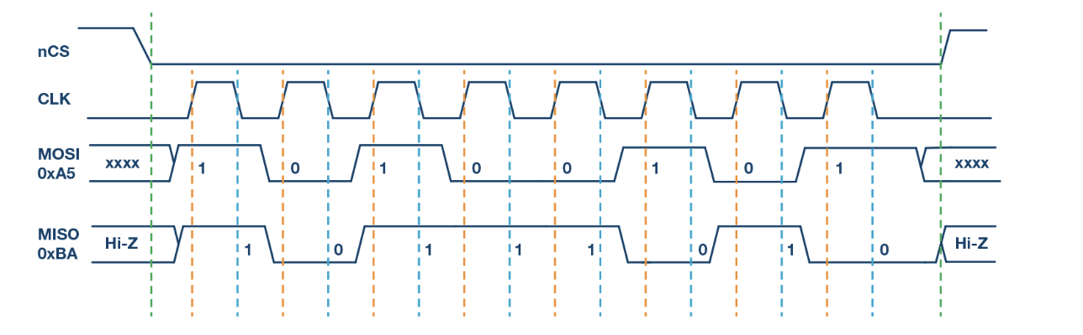
Different modes of operation
SPI (Serial Peripheral Interface) supports four different modes, which determine the clock polarity (CPOL) and clock phase (CPHA) configurations. These modes dictate how the clock signal and data transmission are synchronized between the master and slave devices. The four modes are commonly referred to as Mode 0, Mode 1, Mode 2, and Mode 3.
Mode 0 (CPOL = 0, CPHA = 0):
Clock Polarity (CPOL): 0 (clock idle low)
Clock Phase (CPHA): 0 (data captured on first clock edge, propagated on the following edge)
In this mode, the clock signal is normally low (0) when idle, and data is captured on the rising edge of the clock and propagated on the falling edge.

Slide 5
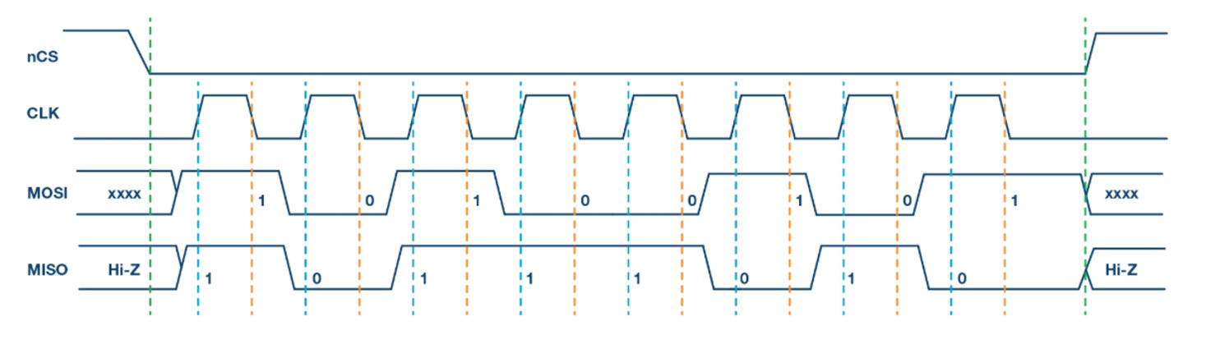
Mode 1 (CPOL = 0, CPHA = 1):
Clock Polarity (CPOL): 0 (clock idle low)
Clock Phase (CPHA): 1 (data propagated on first clock edge, captured on the following edge)
The clock signal is still normally low (0) when idle, but data is captured on the falling edge of the clock and propagated on the rising edge.

Slide 6
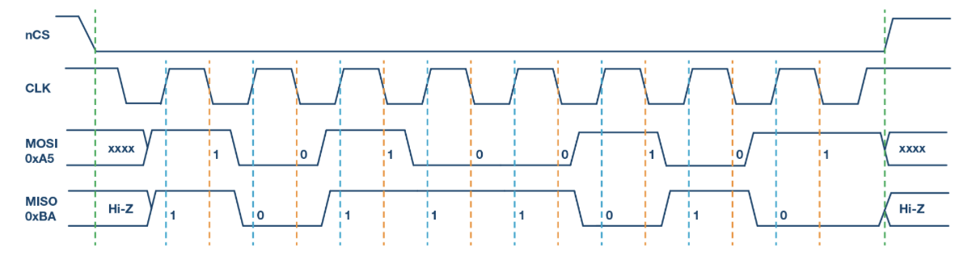
Mode 2 (CPOL = 1, CPHA = 0):
Clock Polarity (CPOL): 1 (clock idle high)
Clock Phase (CPHA): 0 (data captured on first clock edge, propagated on the following edge)
The clock signal is normally high (1) when idle, and data is captured on the falling edge of the clock and propagated on the rising edge.

Slide 7
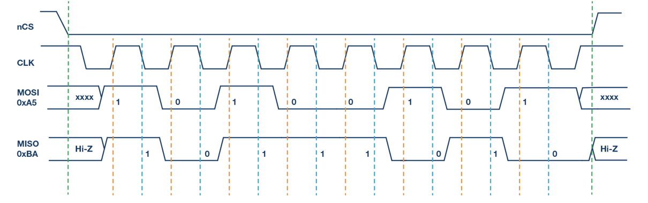
Mode 3 (CPOL = 1, CPHA = 1):
Clock Polarity (CPOL): 1 (clock idle high)
Clock Phase (CPHA): 1 (data propagated on first clock edge, captured on the following edge)
The clock signal is normally high (1) when idle, and data is captured on the rising edge of the clock and propagated on the falling edge.

Slide 8
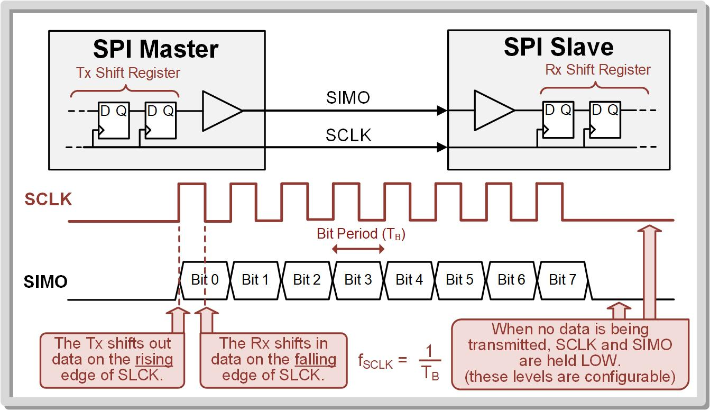
The most widely used mode is Mode 0 where:
When transmitting, the data is shifted out on the rising edge of SCLK.
When receiving, the data is shifted in on the falling edge of SCLK.
When not transmitting, SCLK is held in an idle state.

Slide 9
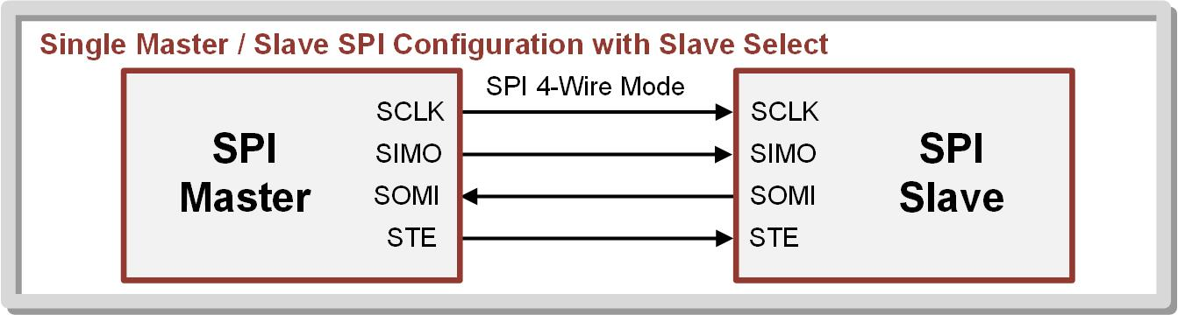
4 pin Configuration
When multiple slaves are used in the system, a slave transmit enable (STE) or slave select (SS) line can be generated by the master in order to dictate which slave is being communicated with.
This is called 4-wire mode.
In 4-pin master mode, the STE pin can be configured to be either an active HIGH or LOW output enable for the slaves.

Slide 10
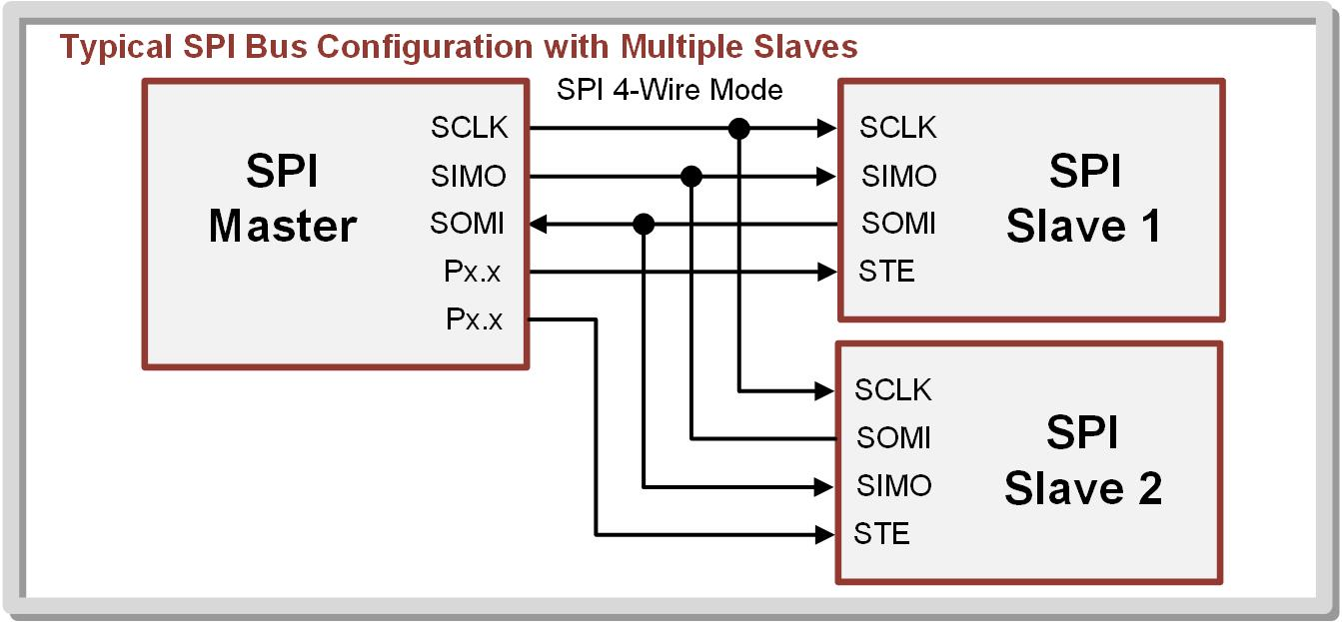
Bus Configuration- Typical
The SIMO and SOMI lines are shared between the master and slaves.

Slide 11
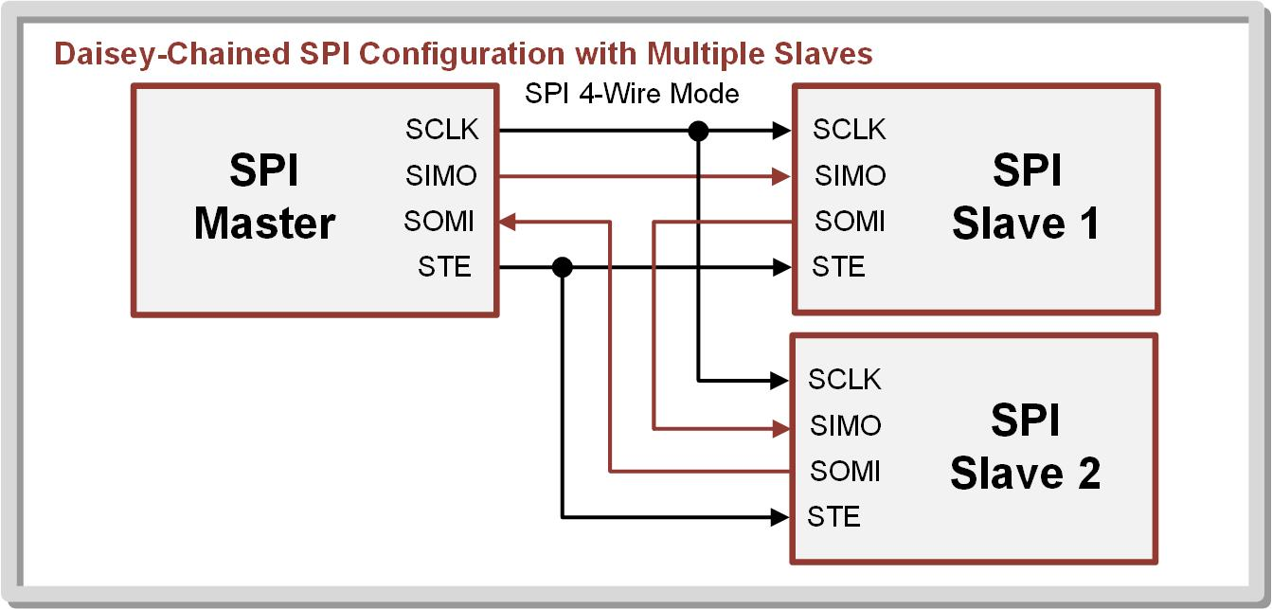
Bus Configuration- Daisy Chained
Devices are wired to form a single, continuous data loop among all the SPI devices.

Slide 12
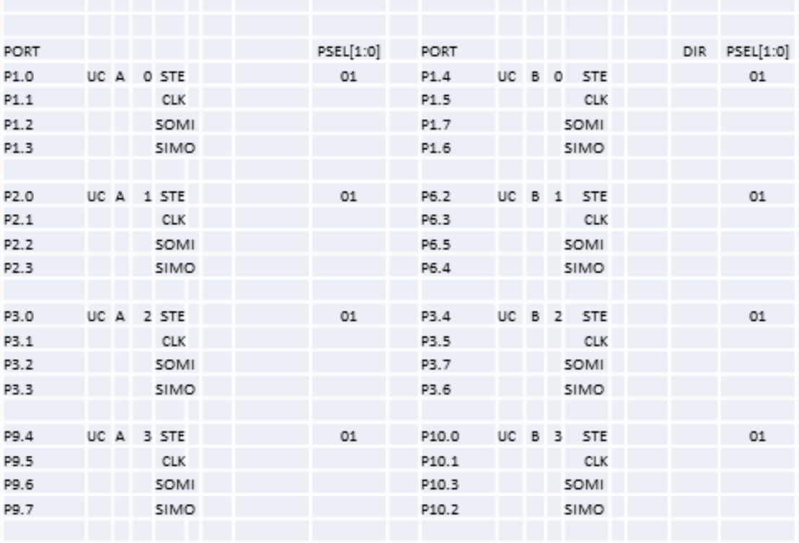
Pins

Slide 13
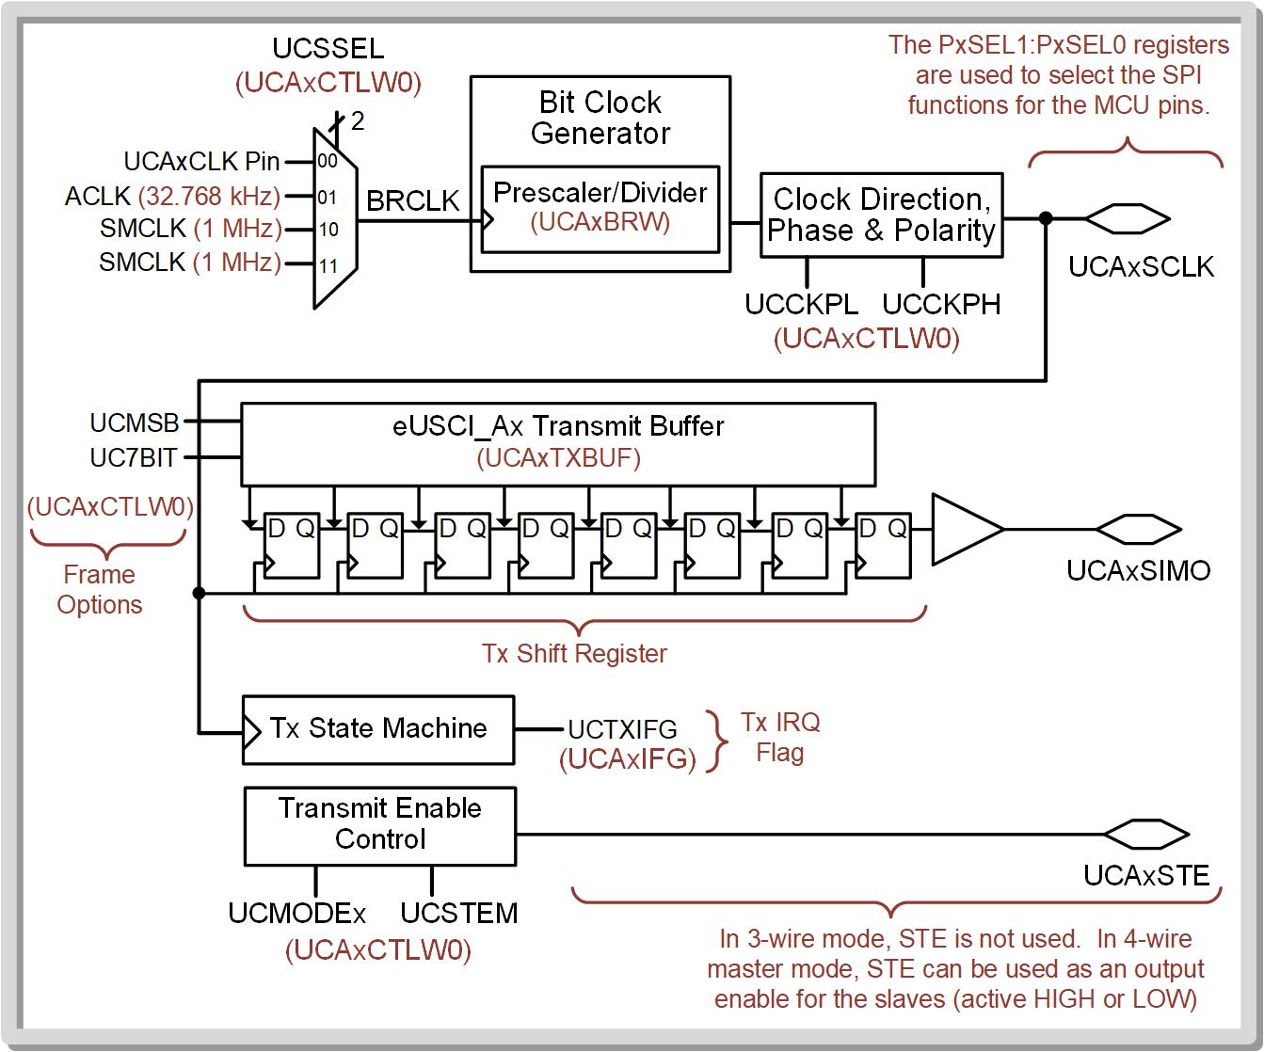
SPI Transmit Block Diagram

Slide 14
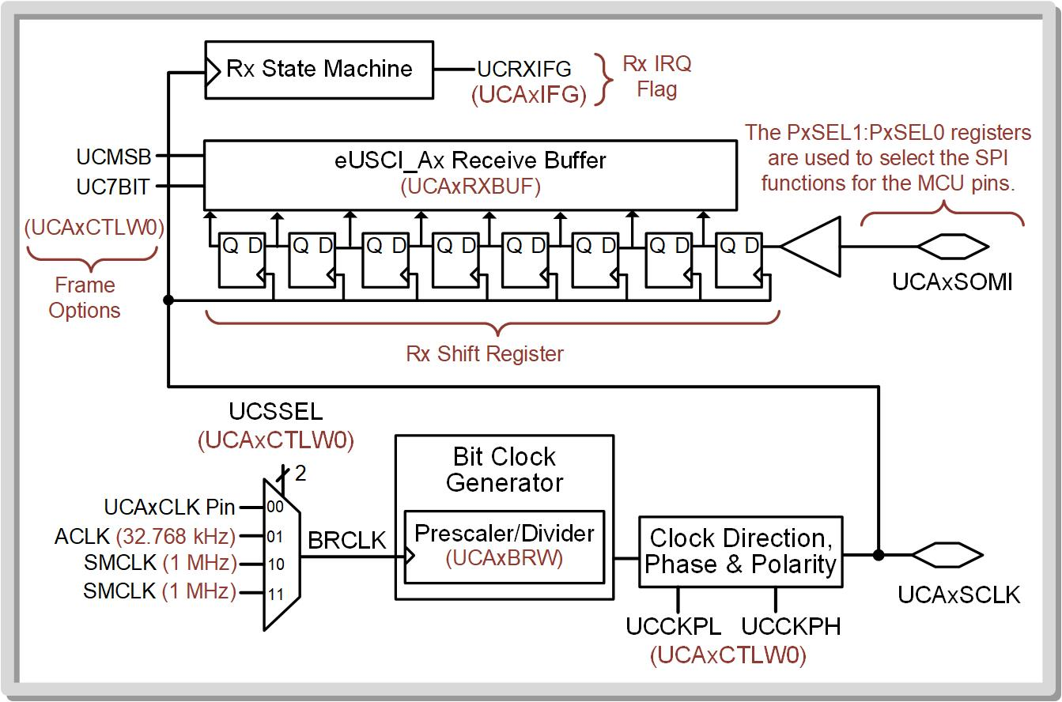
SPI Receive Block Diagram

Slide 15
As Master TX
Configure system to have the desired bit rate and frame characteristics.
Store the data to be transmitted into a Tx buffer, and a shift register automatically sends the data out over the SIMO pin in a serial pattern.
The master sends out eight transitions on SCLK corresponding to each bit that was sent on SIMO.
Transmit interrupt (UCTXIFG) – Indicates Tx buffer is empty.

Slide 16
As Master RX
Configure system to have the desired bit rate and frame characteristics.
The master sends out eight transitions on SCLK corresponding to each bit to be received on SOMI.
Receive interrupt (UCRXIFG) – used to indicate when the Rx buffer is full.

Slide 17
As Slave TX
Configure system to have the desired bit rate and frame characteristics.
Store the data to be transmitted into a Tx buffer.
Wait for master to clock the data out using SCLK.
Transmit interrupt (UCTXIFG) – Indicates Tx buffer is empty.

Slide 18
As Slave RX
Configure system to have the desired bit rate and frame characteristics.
Wait for master to send data & clock.
Receive interrupt (UCRXIFG) – used to indicate when the Rx buffer is full.

Slide 19
Configuration Registers
eUSCI_Ax Control Word 0 (UCAxCTLW0) – has different bit fields when in SPI mode.
eUSCI_Ax Bit Rate Control Word (UCAxBRW) – same function as in UART mode.
eUSCI_Ax Status (UCAxSTATW) – has different bit fields when in SPI mode.
eUSCI_Ax Receive Buffer (UCAxRXBUF) – same function as in UART mode.
eUSCI_Ax Transmit Buffer (UCAxTXBUF) – same function as in UART mode.
eUSCI_Ax Interrupt Enable (UCAxIE) – only has TXIE and RXIE fields.
eUSCI_Ax Interrupt Flag (UCAxIFG) – only has TXIFG and RXIFG fields.
eUSCI_Ax Interrupt Vector (UCAxIV) – only has codes for TXIFG and RXIFG IRQs.

Slide 20
SPI Transmission as Master TX
Step 1: Set the UCSWRST bit in the UCAxCTLW0 configuration register to put the eUSCI_Ax peripheral into software reset.
Step 2: Initialize all eUSCI_Ax configuration registers.
Step 3: Configure ports.
Step 4: Clear UCSWRST to take the eUSCI_Ax peripheral out of reset.
Step 5: Enable interrupts (optional) in the UCAxIE configuration register.

Slide 21
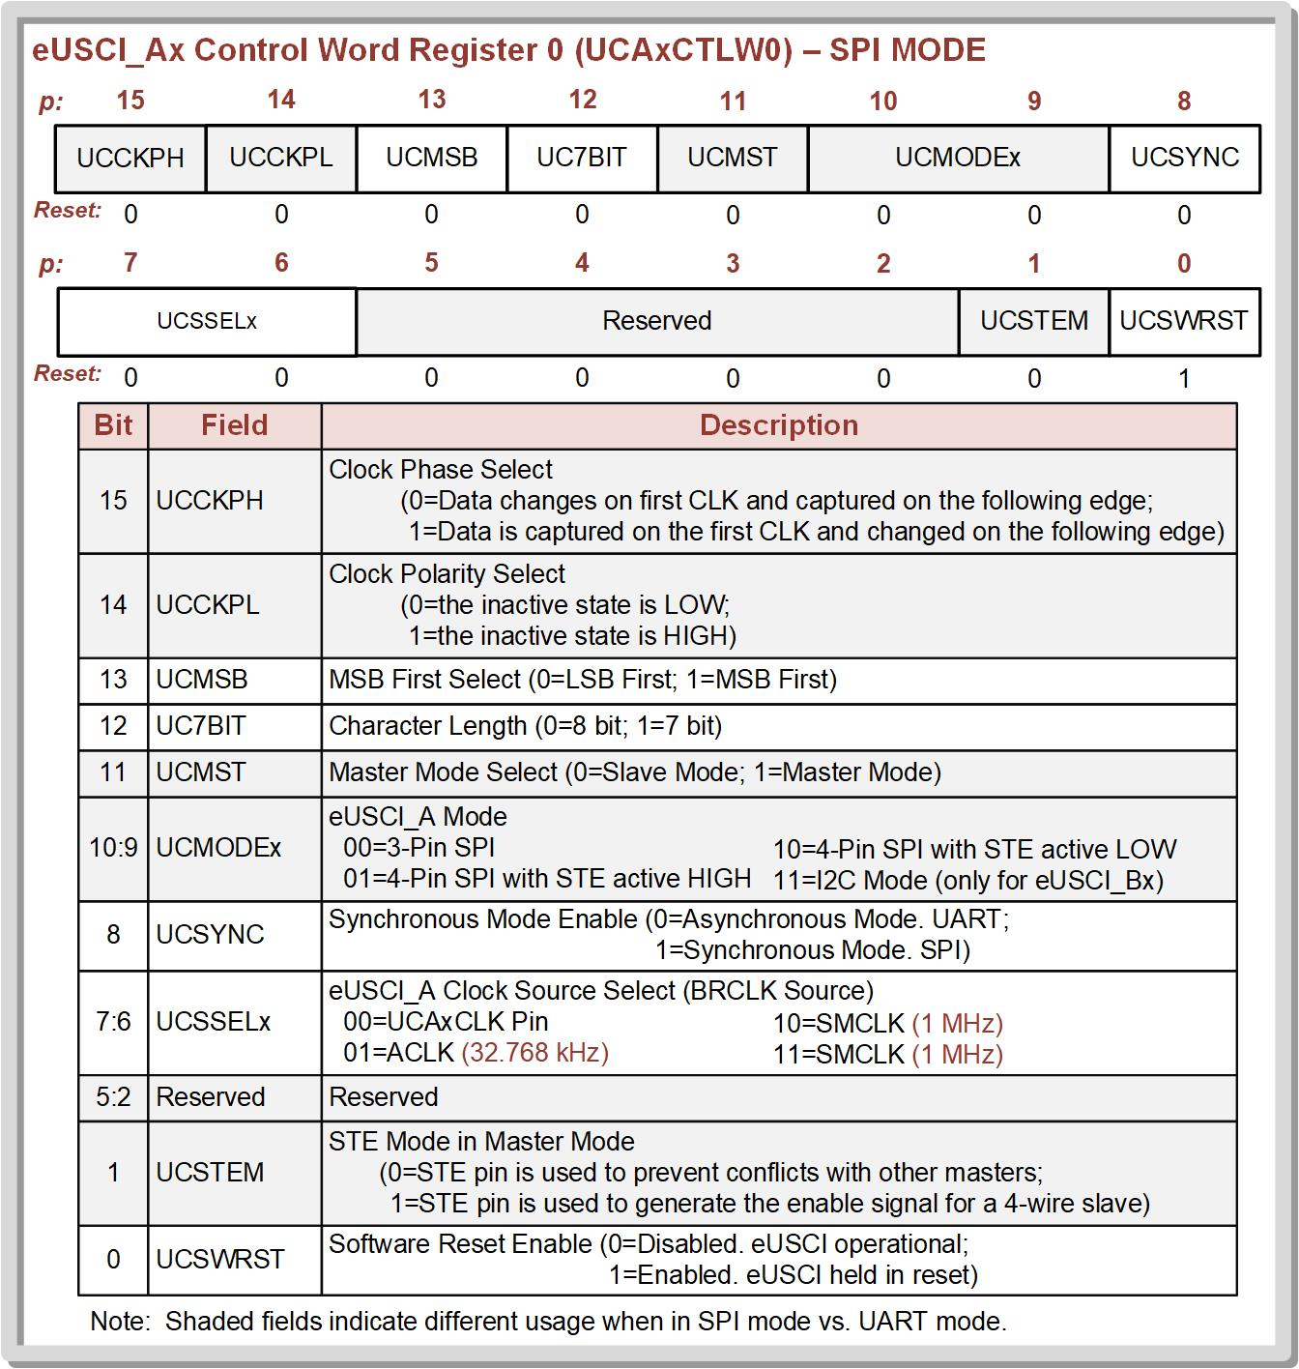
Control Word register
The UCSYNC bit sets the peripheral to either UART (UCSYNC = 0) or SPI (UCSYNC = 1) mode.
The clock source is set using UCSSEL.
The clock edge behavior is set using UCCKPH.
The clock polarity is set using UCCKPL.
The SPI can be set as master or slave using UCMST.

Slide 22
The mode can is set using UCMODEx (i.e., 3-pin vs. 4-pin).
LSB vs. MSB first is set using UCMSB.
7-bit vs. 8-bit is set using UC7BIT.

Slide 23
Transmit interrupt (TXIFG) – tracks whether the Tx buffer has finished sending the last byte and is ready to send more data.
Each time the Tx buffer is written to, it will clear the TXIFG flag.
Each time the Tx buffer is empty and is ready for more information, the TXIFG flag will be set.
The TXIFG flag can be used to trigger an interrupt if TXIE and global interrupts are enabled.

Slide 24
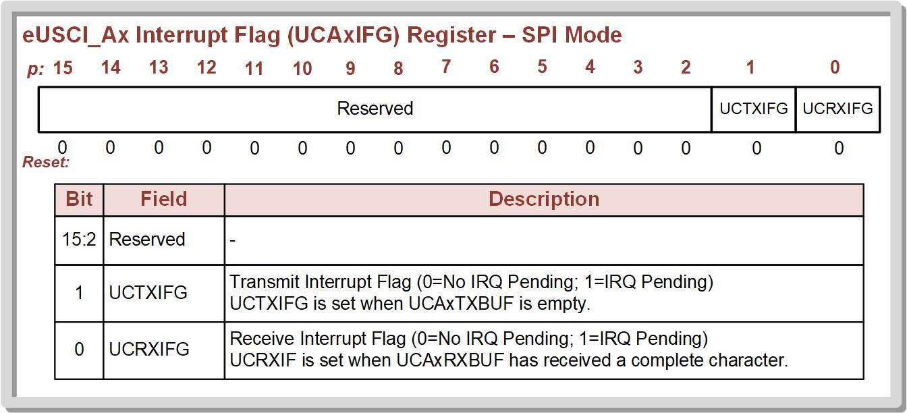
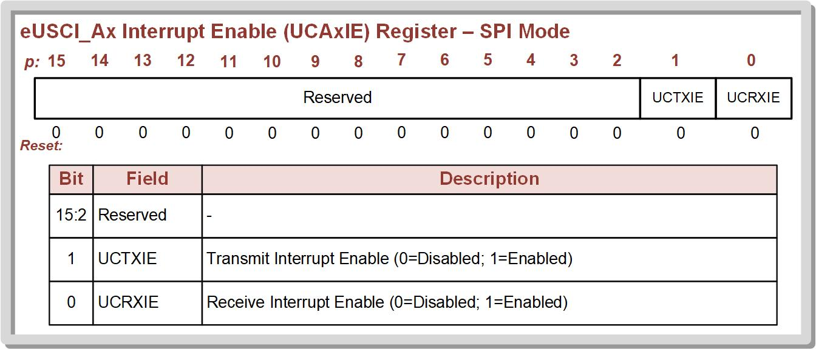

Slide 25
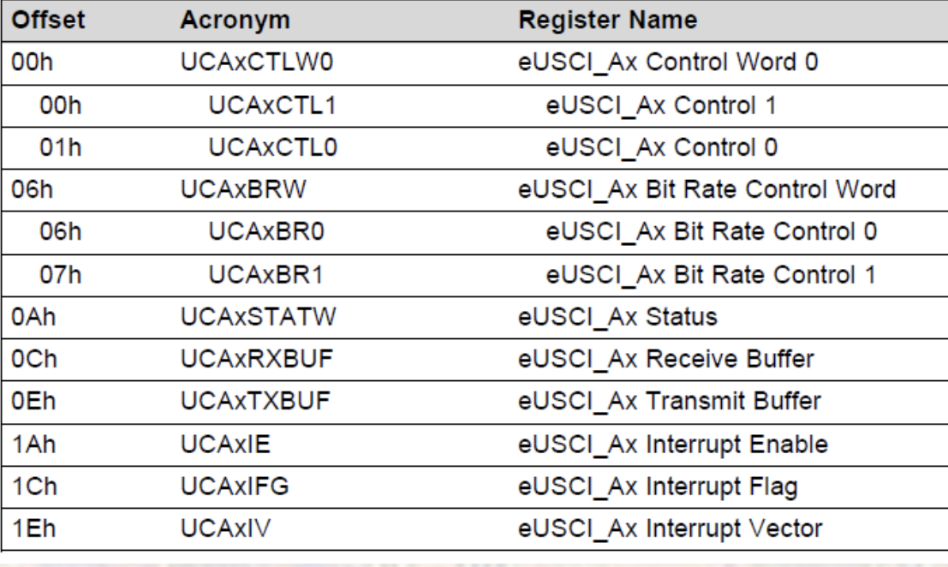
eUSCI_A Registers Applicable for A0,A1,A2,A3

Slide 26
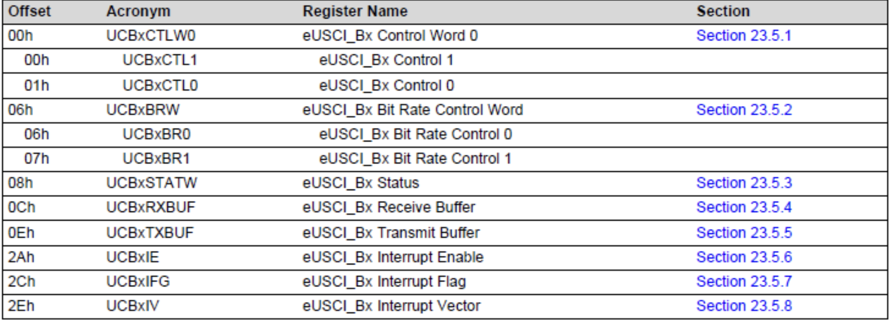
eUSCI_B Registers Applicable for B0,B1,B2,B3

Slide 27
Receiving Data as Master
As Master, you still need to setup the clock.
Since the master generates SCLK, it must send the necessary clock pulses to the slave for the slave to shift out its data block into the master Rx shift register.
This is accomplished by writing a dummy byte of any value to the Tx register on the master in order to force the system to generate 8 SCLK pulses.

Slide 28
The data is received through an Rx shift register.
When all bits have been shifted in, the data is moved to an Rx buffer.
The RXIFG flag is set when new data has arrived in the buffer.

Slide 29
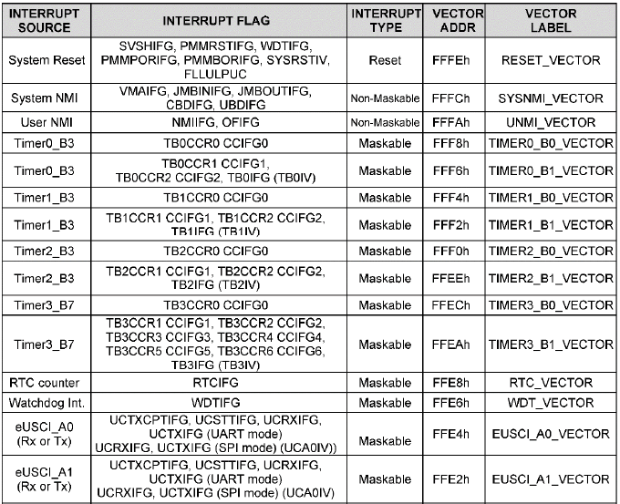
Interrupts can be generated by the RXIFG by enabling the RXIFG bit in the UCAxIE register.
The Rx and Tx IRQs share the same vector.[A0-A3, B0-B3]

Slide 30
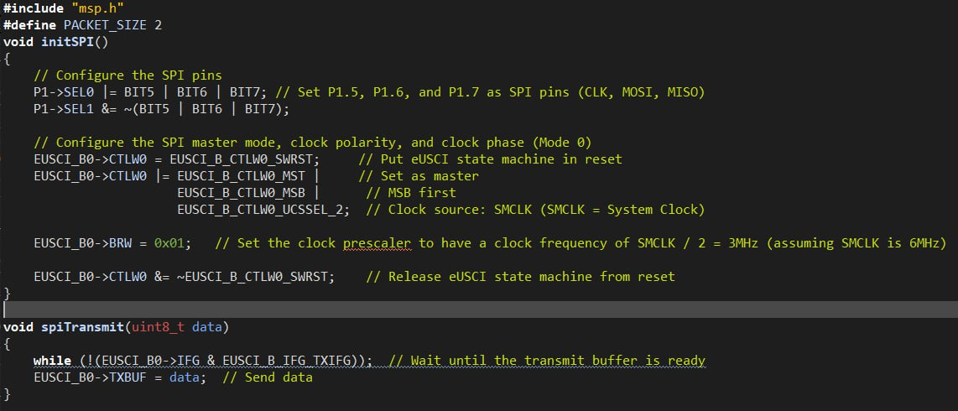
Sending two packets of data as SPI Master TX

Slide 31
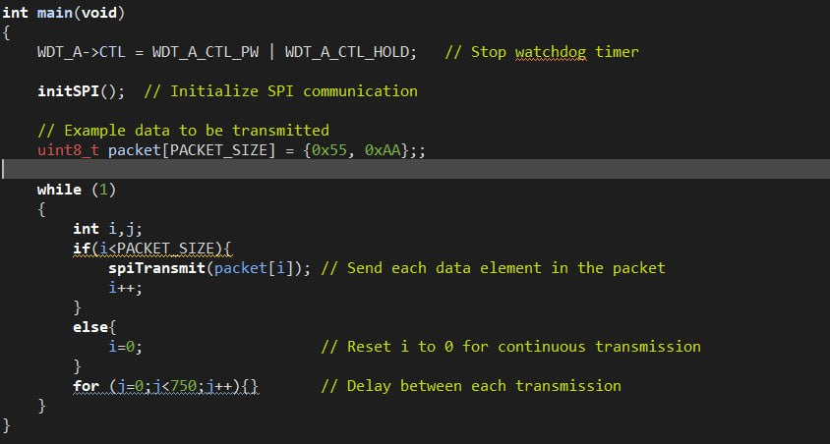

Slide 32
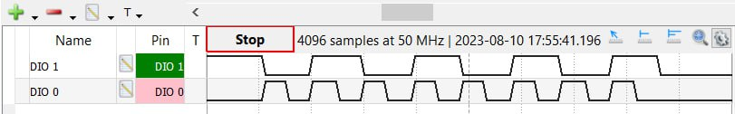
Output
Note that MSB is sent first, so we got 01010101= 0x55
MOSI
CLK
0 1 0 1 0 1 0 1

Slide 33
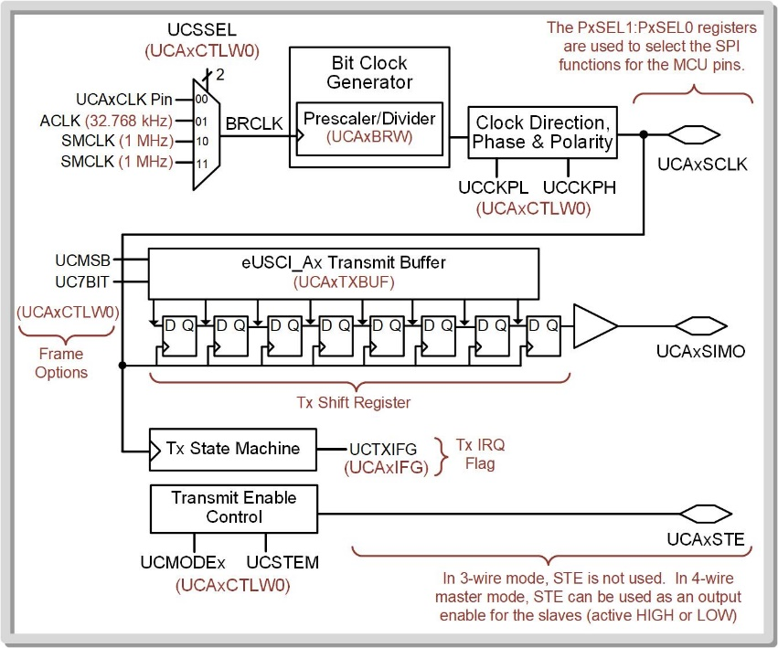
SPI as a Slave
To put into slave mode (default), configure UCMST=0.
Remember the slave doesn’t provide a clock, so there is no UCSSEL and BRW setup needed.
SCLK comes into the peripheral from the external master.
The clock phase and polarity DO need to be configured.

Slide 34
Transmitting as a SPI Slave
The data framing and STE behavior needs to be configured to match the master. - 3-pin vs. 4-pin mode - STE polarity - LSB vs. MSB - 8-bit vs. 7-bit

Slide 35
Transmitting as a SPI slave consists of placing data into the Tx buffer and then waiting for the master to send eight SCLK pulses to shift the data out.
The slave never knows when SCLK will arrive.
It must use the TXIFG to indicate data has been taken by the master.

Slide 36
Receiving as a SPI Slave
Configure the SPI peripheral to match the master.
Wait for the RXIFG IRQ to fire.
Read RX Buffer.

